Slide 1

.

Slide 2
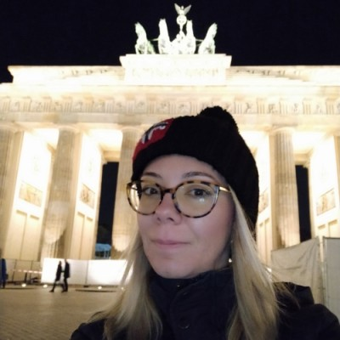




Meet The Team
Angela Distratis
David Barmaz
Ruba Aburub
Harout Mardirossian
Farah Fahhoum
Notes:
Introduce yourself : (Name, Educational background, Work/course name, Country)

Slide 3
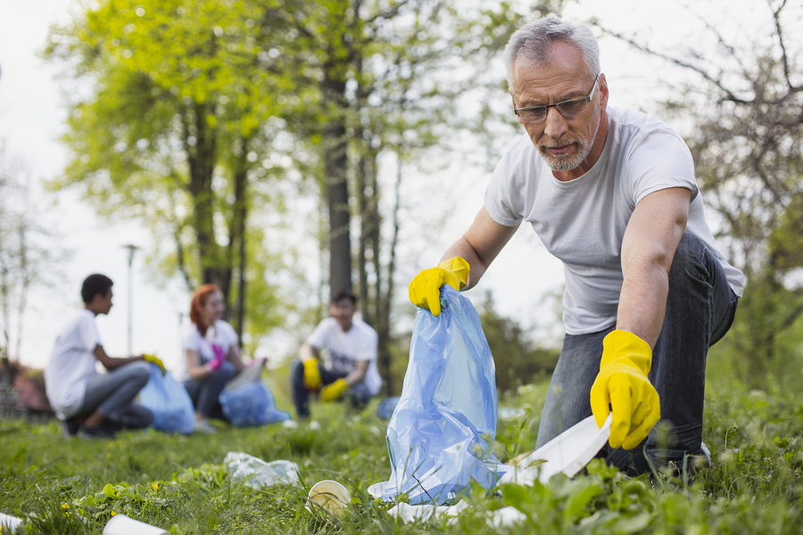
Some Facts
1- The United Nations has stated that “volunteerism is an important component of any strategy aimed at poverty reduction, sustainable development and social integration.” Throughout the world, the number of people participating in volunteer activities is increasing.
2- According to a 2015 survey by Marriott Rewards from Chase, 84% of millennials said that they would travel
abroad to participate in volunteer activities.

Slide 4
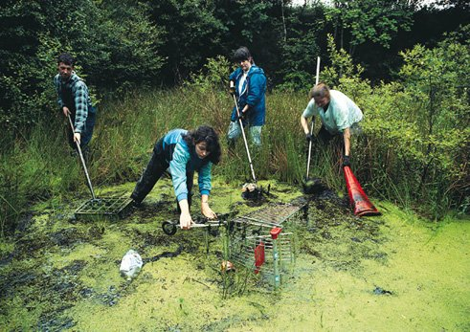
3- Also in 2020 Forbes article, it stated that: “In travel trends sustainability became a deciding factor for individuals “.
4- 2017 article by booking.com 87% of people said they wanted to travel sustainably.
5- Traveles.org 71% of global travellers think companies should offer more sustainable travel choices.
6- 10 million using skyscanner selected
lowest CO2 emission flights.
More Facts...

Slide 5
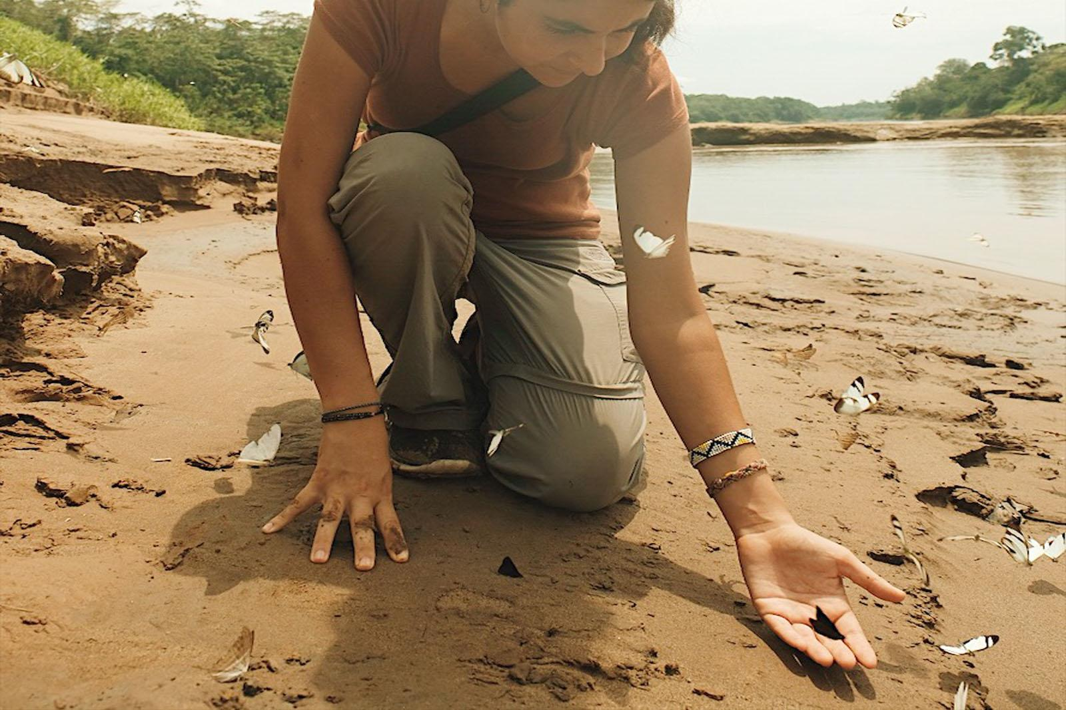
More Facts..
7- “73% of global travellers intending to stay at least once in an eco-friendly or green accommodation when looking at the year ahead.” (Booking.com 2019)
8- “Additionally, 70% of global travellers say they would be more likely to book an accommodation knowing it was eco-friendly, whether they were looking for a sustainable stay or not.

Slide 6
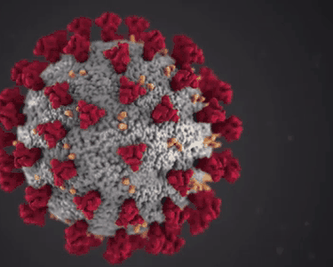
So, we found our inspiration in... the heart of the pandemic.
So, what are we trying to solve ?
Many people want to travel and volunteer at the same time to give back to the environment, but right now, this is hard to do - there is no platform allowing travellers to easily find simple volunteering and Eco-friendly activities they can do while travelling.
Notes:
Why covid inspired us and how?
What is the issue we are trying to solve?

Slide 7
What is our solution ?
We came up with a platform that allows locals to advertise volunteering for Eco- friendly activities that would benefit their communities and the local environment, that involves ratings and rewards.
How we will make it work - our idea is not just to create a platform, but to create a system that rewards volunteers, that incentivise them to volunteer more, and getting their family and friends engaged with the activity they are doing.
Screenshot of the website: to be added.

Slide 8
DEMO
Link: to be added

Slide 9
What we are all about!
Volunteering
VolunTopia
Travel
Sustainability

Slide 10

As a seamlessly integrated combination of
Eco-friendly voluntary service in
a destination and the best, traditional elements
of travel – arts, culture, geography, and
history – in your travel ..
We invite you to join us on our journey, and
make VolunTopia, the future of
sustainable travel.

Slide 11
Thank you very much for your attention ! :D
Any Questions?

